Slide 1
Introduction to Programming I in Java (CSE8A)
Winter 2020

Slide 2
Joe
I like to be called "Joe" (or "Professor Politz" if you prefer using a title)
I like to study & build programming languages
I like dogs
I really like programming
I grew up in Massachusetts (near Boston, East Coast of USA)

Slide 3
Staff Introductions
We have 22 staff members (3 TAs and 19 tutors)
We are here to help! You can ask questions online and in person

Slide 4
What are (some) programs?
input output
prism raw data charts/analyses
spss
matlab
r
jupyter notebooks
powerpoint
photoshop picture/image picture/image (modified)
steam
minecraft (+ mods) controller input game behavior
instagram
final cut
google (drive/mail)
file explorer.....

Slide 5
What are (some) programs?
input output
app store
webreg
angry birds touch input video/sound
game behavior (next level,
bird motion, etc)
google drive
snapchat image/sound/text/location snap, shared w/others
tiktok
instagram
weather app

Slide 6
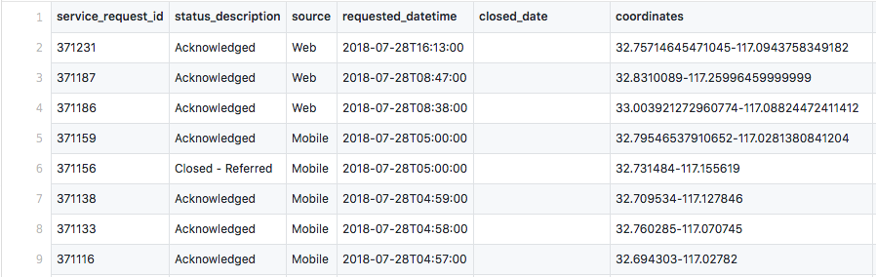
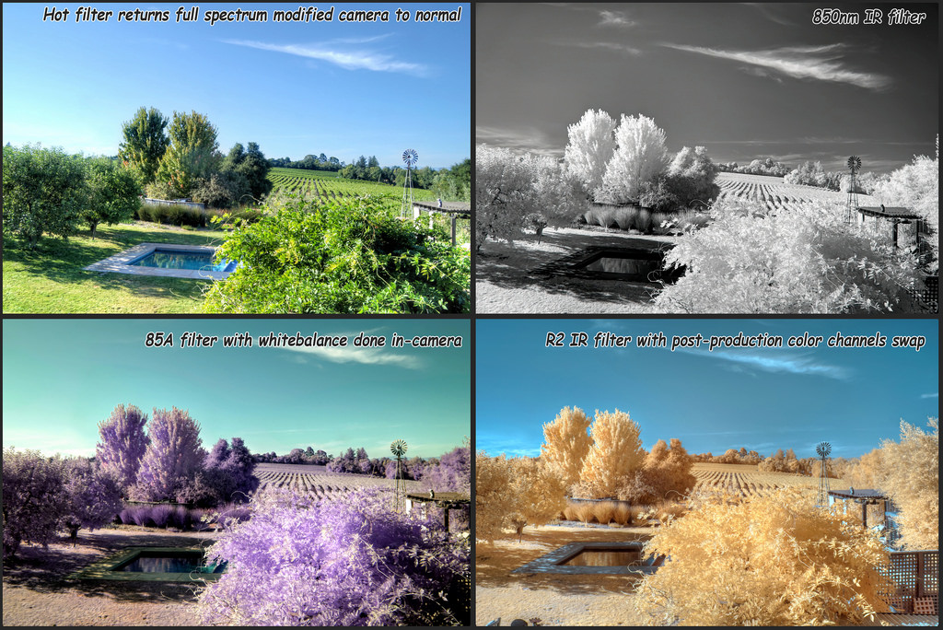
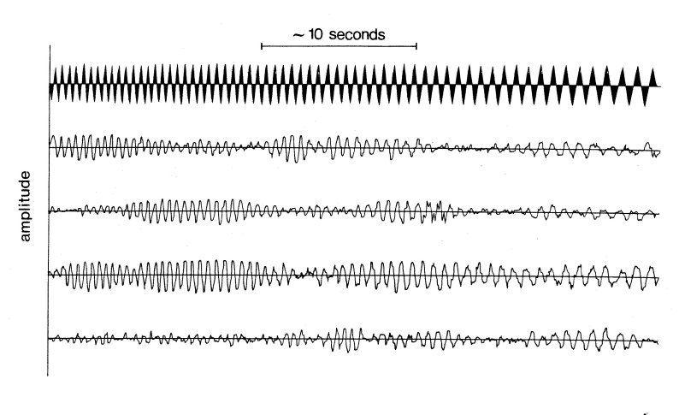
This course – work with interesting data
Notes:
Speaker notes

Slide 7

The Course Website – It's Useful!
Go to: https://ucsd-cse8a-w20.github.io
Or search for "Joe Politz UCSD"

Slide 8
Reading & programming practice
We will be using a service called Stepik, you can join the class at a link on (you guessed it) the course web site.
Programming practice and quiz questions

Slide 9

Programming assignments/projects
Due Tuesday evening at 10pm (but really by midnight)
Many will be open-ended exploration

Slide 10
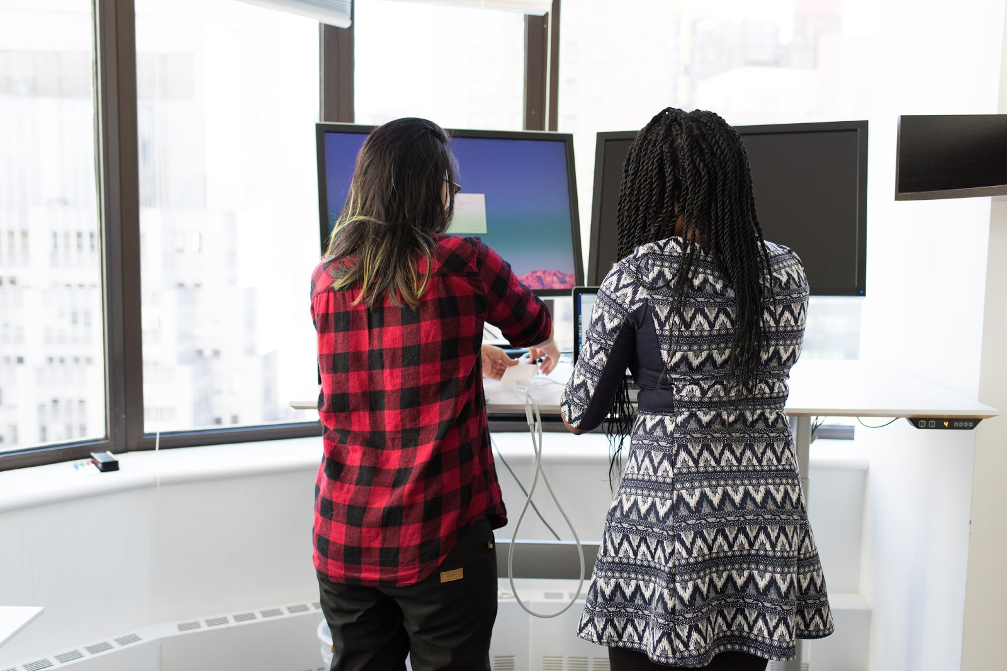
Assigned lab sections
On Wednesdays, attend the section for which you are assigned
Work in groups
Lab report + attendance for credit
Lowest score dropped
If you are waitlisted, we don't have room in the labs for you this week. The assignment will be posted online, you should still do your best to complete it. You will not earn credit for the first lab (it will be the dropped score).

Slide 11
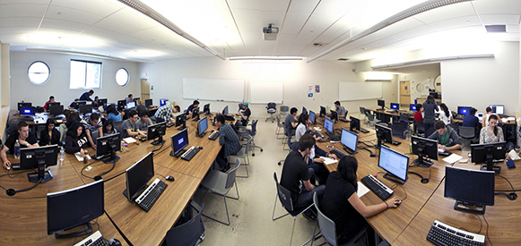
Open lab hours
Ask for help while working on your programming assignments!
Calendar on the course web site lists times when tutors are available.

Slide 12
On-line Q&A via Canvas
Discussions with public questions/replies for lectures and readings
Frequently asked questions posts for programming assignments
Private messages to ALL course staff for questions that can't be public

Slide 13
Devices in class

Slide 14
Devices in class
You can use a device in class BUT
It must have content on the screen directly related to the current lecture
If it does not, you must be sitting in the back two rows of the room
Prof Shriram Krishnamurthi has summarized some relevant literature on the topic
https://cs.brown.edu/courses/cs019/2018/laptop-policy.html

Slide 15
ieng6 account setup
You have an account that's dedicated to this course
Visit https://sdacs.ucsd.edu/~icc/index.php to find it, you can reset the password to one of your choosing
There will be some time to do this in lab tomorrow, but it helps to do it ahead of time!

Slide 16
Two things due Friday
"PA"0
Available via course web site
Filling out some initial forms for the course
Note IRB form – educational research!
Reading + practice problems
Available via... the course web site!
Reading, quiz questions, and some getting-started programming

Slide 17
Take a break
Talk to the person next to you!
What are you hoping to get out of this course?
Do you typically get up this early?
What are some ways you interact with programming/computing in your life?

Slide 18
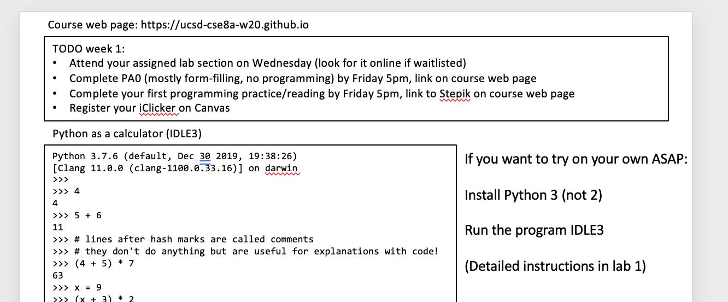
Hello, Python!
What?! The course title said Java!
Get out your worksheet

Slide 19
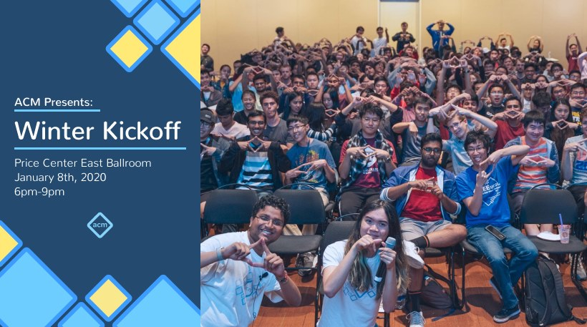
http://acmurl.com/kickoff

